Slide 1
Rotor Blade and Aerodynamics
Week: 3
Date: 07/10/2025
Supervisor: Prof. Dr. rer.nat. Alois Schaffarczyk
Harsh Panchal, Jay Pandya, Kandarp Pathak, Daniyal Sikander

Slide 2
List of contents
Flow Chart
Selected Airfoils
Airfoil Analysis Graphs
Harsh Panchal Matriculation Number 770278

Slide 3
1. Flow Chart
Reynolds number
Airfoil selection according to thickness
Airfoil analysis (Cl/Cd vs AOA),(Cl vs AOA),(Cd vs AOA)
360 degree Polar Generation
Blade Design
Chord , Twist, Bezier Curve( For smooth blade design)
Harsh Panchal Matriculation Number 770278

Slide 4
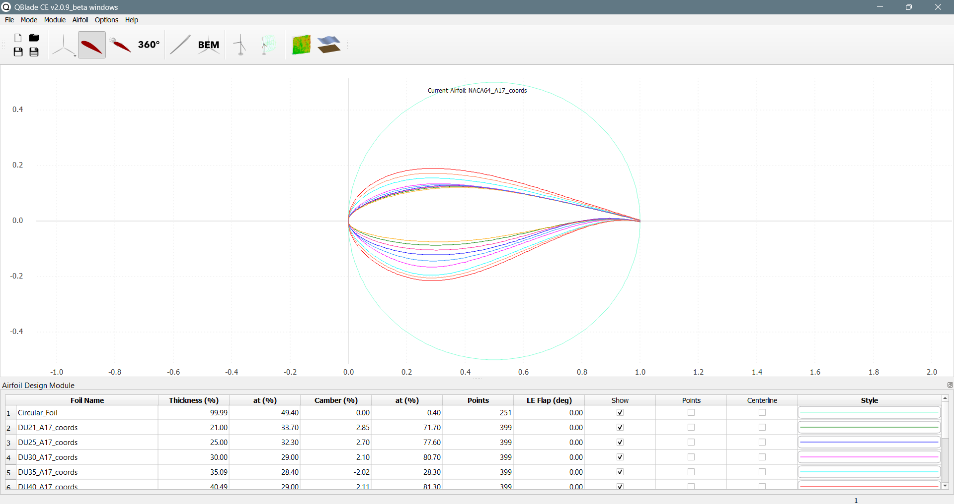
2. Selected Airfoils
Circular Foil 6. DU40
DU21 7. NACA64
DU25
DU30
DU35
Harsh Panchal Matriculation Number 770278

Slide 5
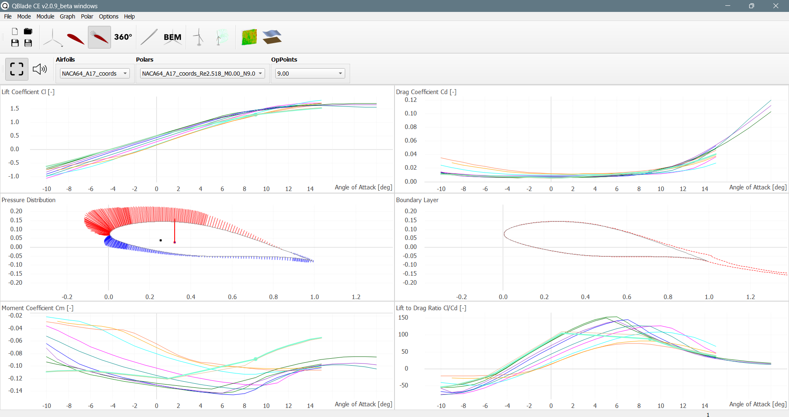
Graphs
Harsh Panchal Matriculation Number 770278

Slide 6
Bibliography
http://airfoiltools.com/search/index?m%5Bgrp%5D=naca4d&m%5Bsort%5D=1
https://qblade.org/
Harsh Panchal Matriculations Number 770278

